Slide 1
Security recommendations
for Blue Ink
Martin Ponce, ID 10371381
CSI1101 Computer Security
ES Off-Campus
Tutor: Patryk Szewczyk

Slide 2
Anti-malware

Slide 3
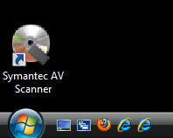
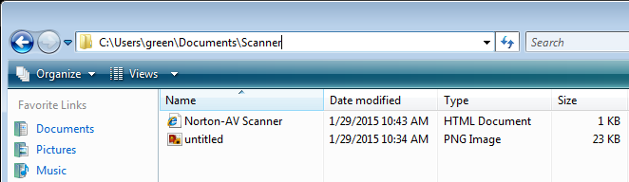
Security issue: Fake anti-virus
Origin unknown
Potentially installed through malware propagation
Offers zero protection
Delete desktop shortcut and supporting files immediately
Replace with legitimate anti-virus application

Slide 4
Recommend: Kaspersky Endpoint Security for Business Advanced 10.2
Variants
Core
Select
Advanced
Total
Advanced variant includes patch management features
Recommended to manage patching of Blue Ink’s devices
Highest scoring patch manager according to AV-TEST
High scoring anti-malware according to AV-TEST

Slide 5
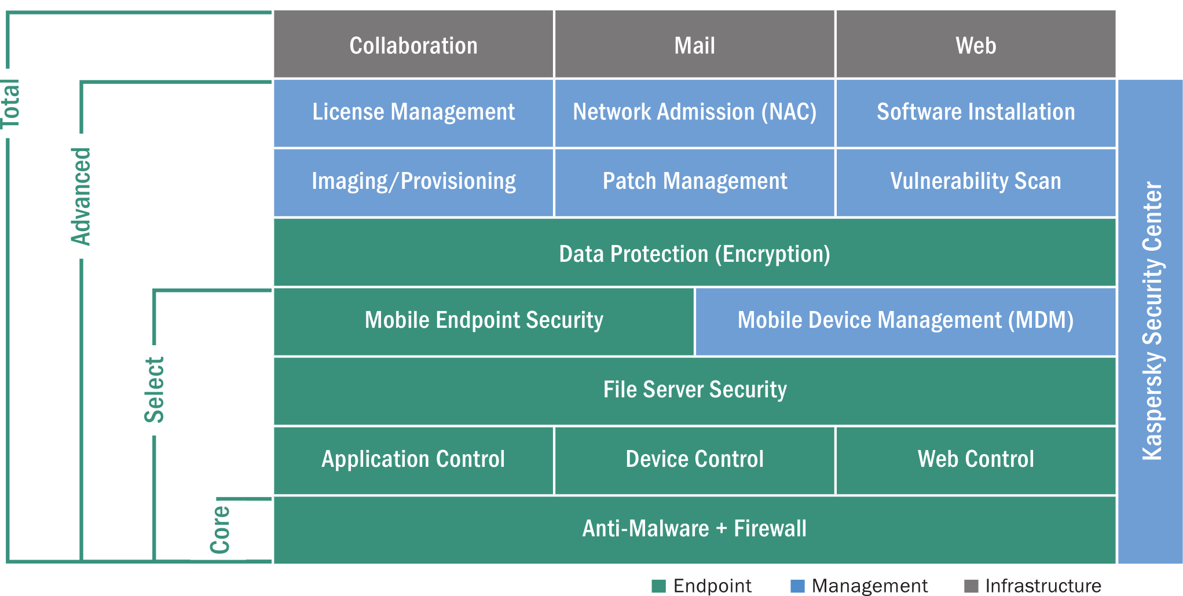
Endpoint Security 10.2 variants overview
(Kaspersky Lab, 2013a, p. 1)

Slide 6
Kaspersky Endpoint Security for Business Advanced 10.2:
AV-TEST compared leading business anti-virus products in December 2014
Kaspersky Endpoint Security 10.2 scored among the highest in protection, performance and usability
Note: Tests for Windows Vista not available
Windows 7 results shown as closest analogue

Slide 7
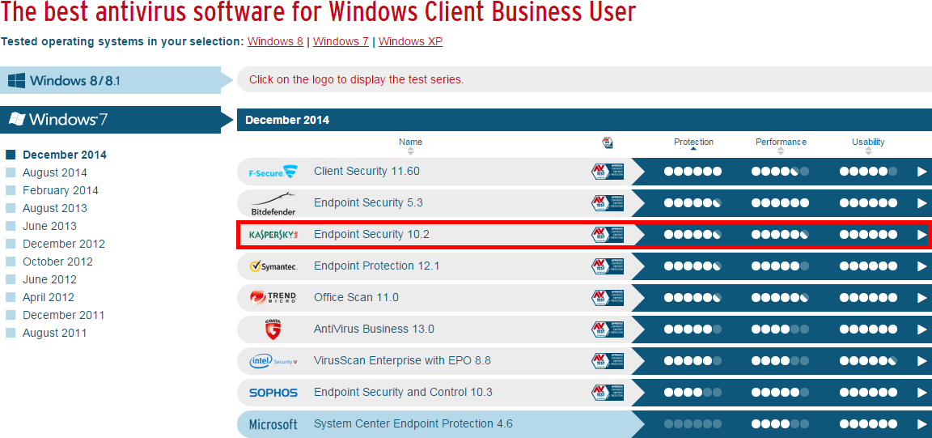
AV-TEST Business Anti-virus comparisons
(AV-TEST, 2014a)

Slide 8
AV-TEST Kaspersky Endpoint Security results
Categories | Tests | November | December | Industry Average
Protection | Against 0-day malware attacks, inclusive of web and email threats (real world testing) 153 samples | 97% | 100% | 92%
 | Detection of widespread / prevalent malware discovered in the last 4 weeks (AV-TEST reference set) 12,327 samples | 100% | 100% | 97%
Performance | Use cases: visiting websites, downloading software, installing and running programs and copying data 5 samples | 1s |  | 2s
Usability | False warnings or blockages when visiting websites 500 samples | 0 | 0 | 0
 | False detections of legitimate software as malware during a system scan 425,612 samples | 0 | 0 | 1
 | False warnings concerning certain actions carried out whilst installing and using legitimate software 38 samples | 0 |  | 0
 | False blockages of certain actions carried out whilst installing and using legitimate software 38 samples | 0 |  | 0
* Results based on Windows 7 client (AV-TEST, 2014b)

Slide 9
Patch management

Slide 10
Security issue: OS / application vulnerabilities
Application | CVE | Description
Vista SP0 | CVE-2008-0951 | Auto-run vulnerability
 | CVE-2007-5133 | Denial of Service overflow
Internet Explorer 7 | CVE-2015-0067 | Remote memory corruption
 | CVE-2013-3918 | Active-X Control vulnerability
Firefox 8.0 | CVE-2014-1522 | Remote arbitrary code execution
 | CVE-2014-1532 | Heap memory corruption
Adobe Reader 6.0.1 | CVE-2011-2462 | Remote arbitrary code execution
 | CVE-2009-3959 | Arbitrary code execution via malicious PDF
Mitigate with regular and scheduled patching of OS and applications

Slide 11
Recommend: Kaspersky Endpoint Security for Business Advanced 10.2
Includes patch management features
AV-TEST compared leading business patch management software in June 2013
Kaspersky Security Center 10.1 scored highest for most tests
Note: Security Center 10.2 included in Kaspersky Security for Business Advanced 10.2
Provides efficient way to manage patching on Blue Ink’s devices connected to network

Slide 12
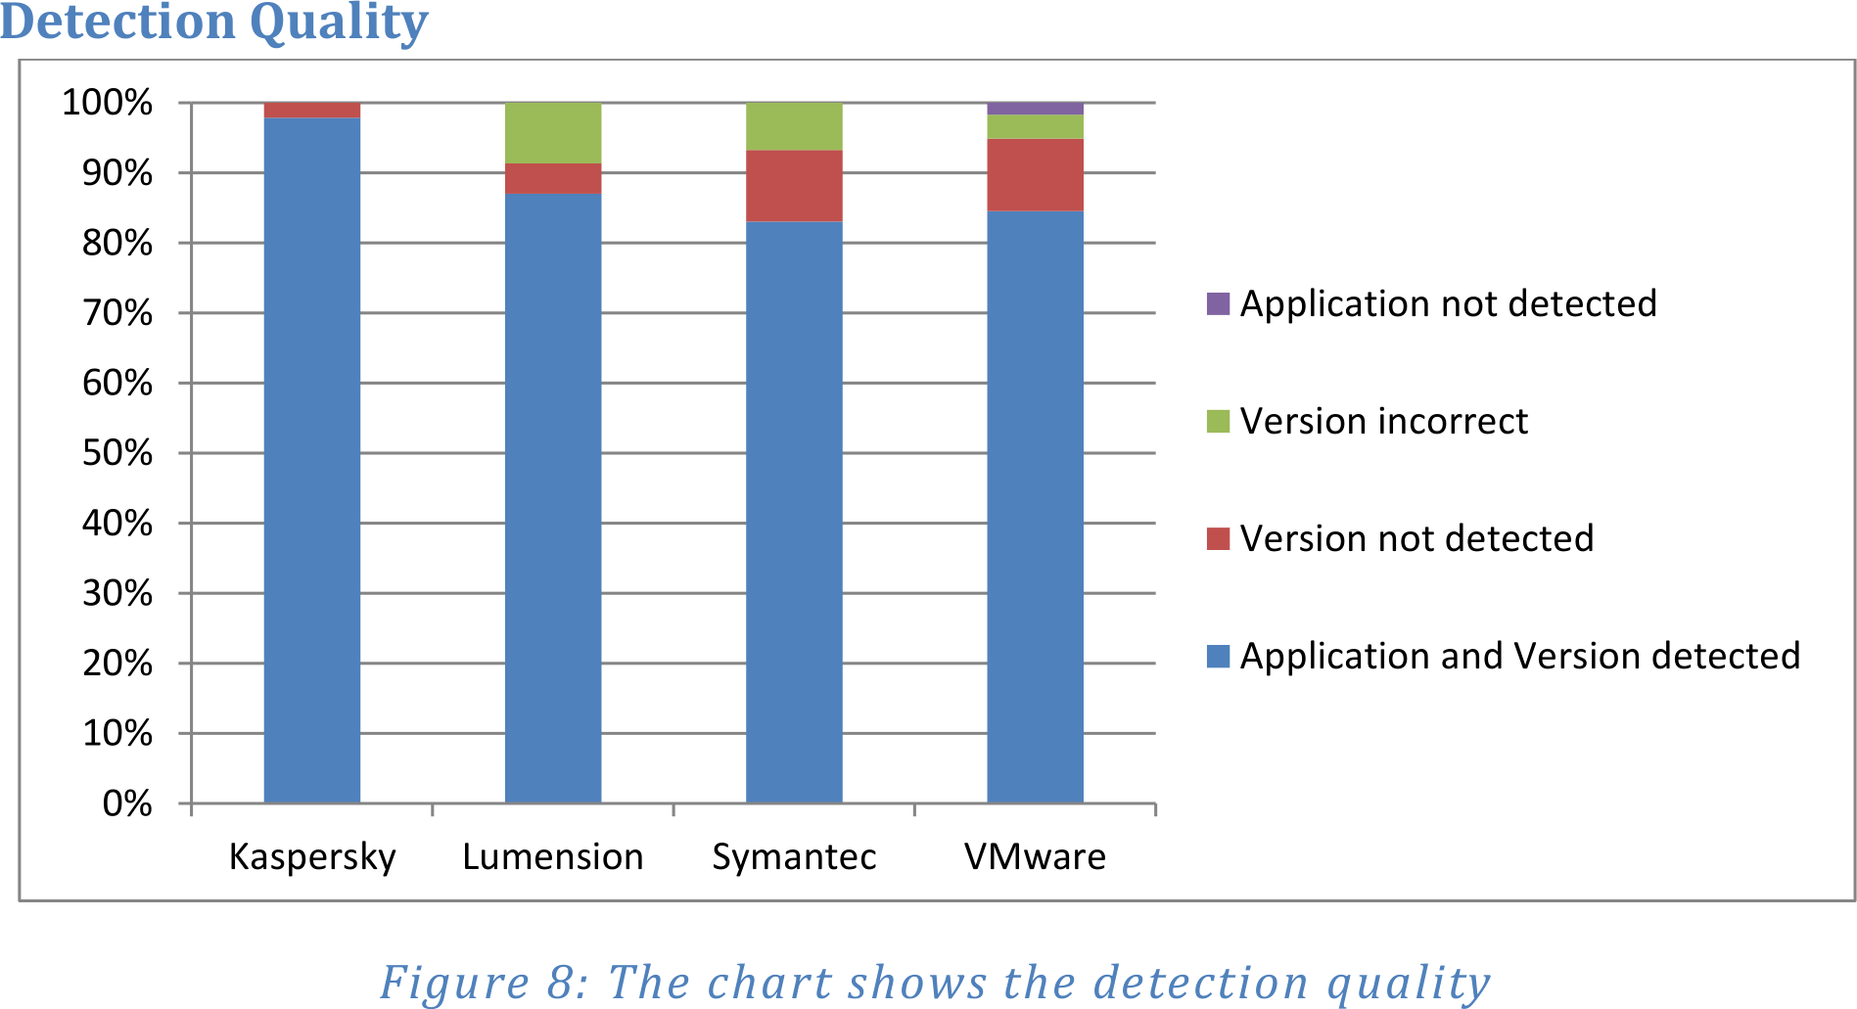
AV-TEST Kaspersky Security Center 10.1 results
Vendor | Supported apps | Detection quality | Reaction rate | Install barrier | Microsoft update support
Kaspersky | ~200 | ~98% | ~4 days | 0% | WSUS
Lumension | ~80 | ~87% | ~11.5 days | ~5% | None
Symantec | ~140 | ~82% | ~4.5 days | ~21% | None
VMWare | ~190 | ~85% | ~4 days | ~9% | None
(AV-TEST, 2013, p. 7)

Slide 13
Advantages: Kaspersky Endpoint Security for Business Advanced 10.2
One software package to address anti-virus and patch management needs
Scored highly by AV-TEST
Mitigate vulnerabilities in OS/applications with security patches
Other anti-virus apps reviewed by AV-TEST do not include patch management features
ie. BitDefender
Provides other features such as firewall and encryption

Slide 14
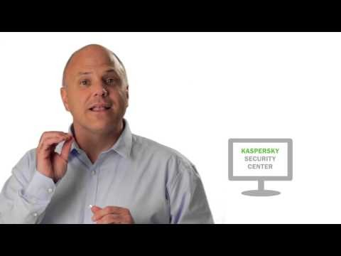
Video: Kaspersky Endpoint Security for Business Advanced (Kaspersky Lab, 2013b)

Slide 15
User and device management

Slide 16

Security issue: Non-existent user / device security policies
Blue Ink computers do not have any security policies
Logs user automatically into an administrator account without authentication
Screensaver not password protected
User Access Control (UAC) disabled
(cohdra, 2005)

Slide 17
Recommend: Active Directory Domain Services (Microsoft, 2007)
Configure Windows 20xx Server as Active Directory Domain Controller
Populate user, group and device databases
Configure group access rights
Reserve admin rights to IT support staff only
Enforce security settings via group policies
Screenserver password protection (Microsoft n.d.-a)
Enable UAC (Microsoft, 2007)
Password strength policies (Microsoft, 2012)
Lock account after failed attempts (Microsoft, 2005b)

Slide 18
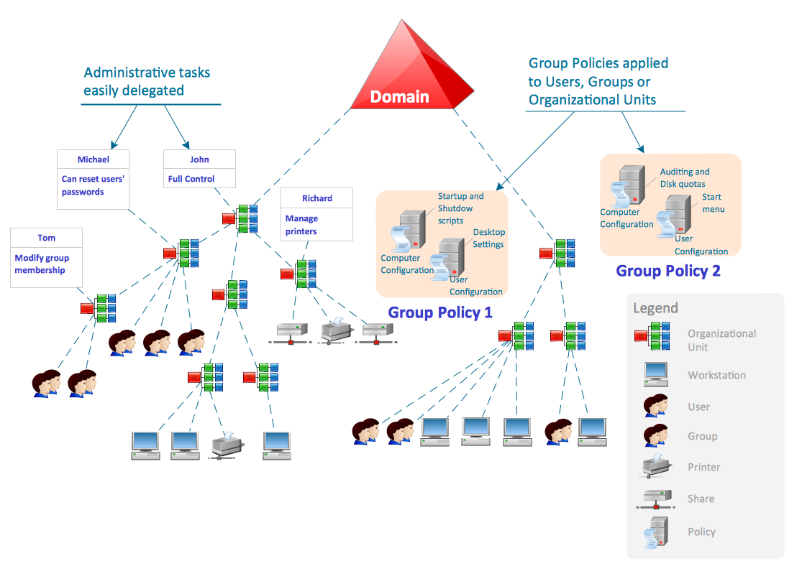
Active Directory model (Concept Draw, n.d.)

Slide 19
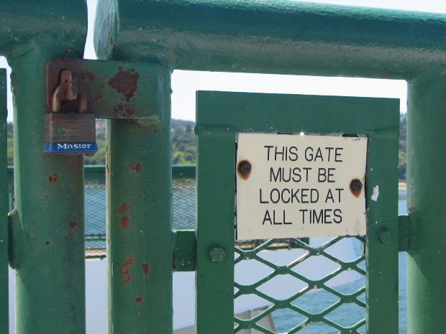
Advantages: Active Directory Domain Services
Native to Microsoft, included with Microsoft Server 20xx
As opposed to alternatives like Novell ZenWorks
Must purchase another software licence
User must authenticate before accessing computer and network resources
Security settings enforced consistently across all devices
(jppi, 2007)

Slide 20
User practices

Slide 21
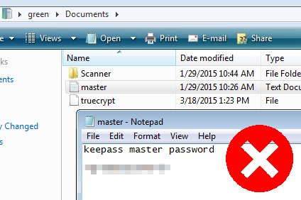
Security issue: Passwords in plaintext
A password was saved in plaintext in a user’s “My Documents” folder
An attacker could easily read password if gained access to computer

Slide 22
Recommend: Delete/destroy passwords in plaintext
Securely delete files containing passwords in plaintext
Include *.pdf, *.xls, *.ppt, etc. Not just *.txt files
Destroy any passwords written down on paper
ie. Sticky notes
Attackers can easily retrieve passwords on paper too
Use of memorable passphrases will mitigate need for writing passwords down

Slide 23
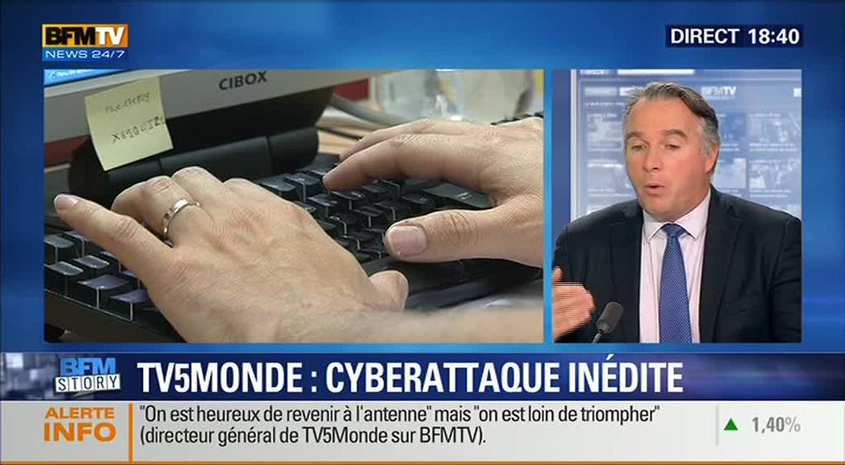
Sticky-note password disclosure on TV (@pent0thal, 2015)

Slide 24

Recommend: Passphrases
Oliver & Snowden (2015) discuss how to select a strong but memorable passphrase
Won’t have to write it down or save in plaintext

Slide 25
Security issue: mIRC Internet Relay Chat
Internet Relay Chat (IRC) share similar risks of malware propagation as email
Attackers may use social engineering to
Convince victims to view links to malicious web pages or files
Convince victims to open malicious files sent directly through IRCs file-sharing protocol
Removal of mIRC will mitigate these risks

Slide 26
Summary

Slide 27
Patch management
Use proactive patch management strategy
Mitigate vulnerabilities in software
Recommend SolarWinds Patch Manager 2.1
Manage patching in large computer network
Passwords
Configure users/groups with Active Directory
Enforce passwords, password policy, screensaver lock, and account lockout after failed attempts
Use passphrases for password policies
Prevent users from writing passwords down

Slide 28
User practices
Do not store passwords in plaintext files or handwritten notes
Remove mIRC to prevent malware propagation
User rights
Configure Active Directory user groups with appropriate user rights
Reserve admin rights for IT support staff
Enforce UAC through Active Directory group policy

Slide 29
Anti-virus and network security
Remove fake anti-virus
Recommend Kaspersky End Point Security Select
Recommend KFSensor honeypot system
Simulates vulnerable services to entice attacker
Diverts attackers away from critical systems in the event an attacker compromises network
Logs events

Slide 30
References
Baker, W. H., Hylender, C. D., & Valentine, J. A. (2008). 2008 Data Breach Investigations Report, 1–29.
Goodin, D. (2014). Stanford’s password policy shuns one-size-fits-all security | Ars Technica. Ars Technica. Retrieved April 30, 2015, from http://arstechnica.com/security/2014/04/25/stanfords-password-policy-shuns-one-size-fits-all-security/
Machkovech, S. (2015). Hacked French network exposed its own passwords during TV interview | Ars Technica. Ars Technica. Retrieved May 6, 2015, from http://arstechnica.com/security/2015/04/09/hacked-french-network-exposed-its-own-passwords-during-tv-interview/
Microsoft. (2005a). Apply or modify password policy: Logon and Authentication. Retrieved May 14, 2015, from https://technet.microsoft.com/en-au/library/cc781633(v=ws.10).aspx?f=255&MSPPError=-2147217396#BKMK_3
Microsoft. (2005b). Assign user rights to a group in Active Directory: Active Directory. Retrieved May 14, 2015, from https://technet.microsoft.com/en-au/library/cc786658(v=ws.10).aspx
Microsoft. (2007). Configure UAC settings via policy - Microsoft Reduce Customer Effort Center - Site Home - TechNet Blogs. Retrieved May 14, 2015, from http://blogs.technet.com/b/asiasupp/archive/2007/02/08/configure-uac-settings-via-policy.aspx
Microsoft. (2012). Password must meet complexity requirements. Retrieved May 14, 2015, from https://technet.microsoft.com/en-us/library/hh994562(v=ws.10).aspx
Microsoft. (n.d.-a). Screen Saver timeout. Retrieved May 14, 2015, from https://technet.microsoft.com/en-us/library/cc961876.aspx
Microsoft. (n.d.-b). What is User Account Control? - Windows Help. Retrieved March 14, 2015, from http://windows.microsoft.com/en-au/windows/what-is-user-account-control#1TC=windows-vista
O’Connor, E. (2008). BigAdmin Feature Article: Patch Management Best Practices. Retrieved May 13, 2015, from http://www.oracle.com/technetwork/systems/articles/patch-management-jsp-135385.html
Oliver, J., & Snowden, E. [LastWeekTonight]. (2015, April 9). Last Week Tonight with John Oliver: Edward Snowden on Passwords. Retrieved May 6, 2015, from https://www.youtube.com/watch?v=yzGzB-yYKcc
Scarfone, K., & Souppaya, M. (2013). Guide to Enterprise Patch Management Technologies NIST Special Publication 800-40 Guide to Enterprise Patch Management Technologies. NIST. doi:10.6028/NIST.SP.800-40r3
Tice, K. [solarwindsinc]. (2012, September 12) Patch Manager Guided Tour. Retrieved May 14, 2015, from https://www.youtube.com/watch?v=-DldViUL1d0

Slide 31
Intrusion detection system

Slide 32
Recommend: KFSensor honeypot system
Windows based honeypot Intrusion Detection System (IDS) designed for corporate environments
Acts as a decoy to attract attackers in the event the network is compromised
Simulates vulnerable FTP, SMB, POP3, HTTP, Telnet, SMTP and SOCKS
Diverts attacks away from critical areas of network
Identifies attack signatures and logs events

